Slide 1
JAVA I/O (Input/Output) streams
Java io package

Slide 2
JAVA I/O
Java I/O (Input and Output) is used to process the input and produce the output based on the input.
Java uses the concept of stream to make I/O operation fast. The java.io package contains all the classes required for input and output operations.
We can perform file handling in java by java IO API.

Slide 3
Stream
A stream is a sequence of data. In Java a stream is composed of bytes. It's called a stream because it's like a stream of water that continues to flow.
In java, 3 streams are created for us automatically. All these streams are attached with console.
1) System.out: standard output stream
2) System.in: standard input stream
3) System.err: standard error stream

Slide 4
Code to print output messages on console
System.out.println("simple message");
System.err.println("error message");

Slide 5
Code to get input from console.
System.out.println("enter character");
int i = System.in.read(); //returns ASCII code of first character
System.out.println((char)i);

Slide 6
Types of Streams
Streams
Byte Streams
Character Streams

Slide 7
Byte Streams
Java byte streams are used to perform input and output of 8-bit bytes. Though there are many classes related to byte streams but the most frequently used classes are ,FileInputStream and FileOutputStream

Slide 8
Character Streams
Character streams are used to perform input and output for 16-bit unicode. Though there are many classes related to character streams but the most frequently used classes are ,FileReader and FileWriter.. Though internally FileReader uses FileInputStream and FileWriter uses FileOutputStream but here major difference is that FileReader reads two bytes at a time and FileWriter writes two bytes at a time.

Slide 9
InputStream
Java application uses an input stream to read data from a source, it may be a file,an array,peripheral device or socket.

Slide 10
OutputStream
Java application uses an output stream to write data to a destination, it may be a file,an array,peripheral device or socket.

Slide 11
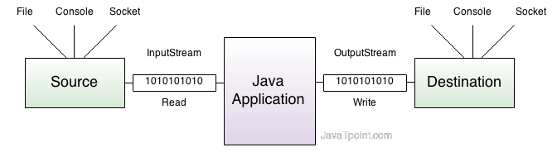
Java Input and Output Streams Flow

Slide 12
InputStream class
InputStream class is an abstract class.It is the superclass of all classes representing an input stream of bytes.

Slide 13
Commonly used methods of InputStream class
Method | Description
1) public abstract int read()throws IOException: | reads the next byte of data from the input stream.It returns -1 at the end of file.
2) public int available()throws IOException: | returns an estimate of the number of bytes that can be read from the current input stream.
3) public void close()throws IOException: | is used to close the current input stream.

Slide 14
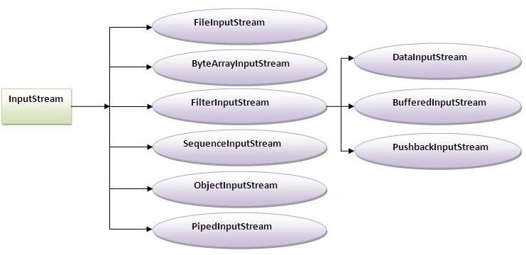
Input Stream Class Hierarchy

Slide 15
Output Stream class
OutputStream class is an abstract class.It is the superclass of all classes representing an output stream of bytes. An output stream accepts output bytes and sends them to some sink.

Slide 16
Commonly used methods of OutputStream class
Method | Description
1) public void write(int)throws IOException: | is used to write a byte to the current output stream.
2) public void write(byte[])throws IOException: | is used to write an array of byte to the current output stream.
3) public void flush()throws IOException: | flushes the current output stream.
4) public void close()throws IOException: | is used to close the current output stream.

Slide 17
Note
No need to call flush() before calling close(). Just call close() is enough

Slide 18
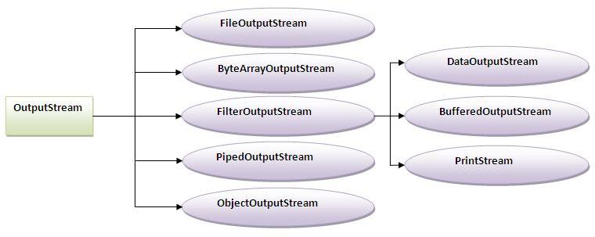
Output Stream class hierarchy

Slide 19
FileInputStream and FileOutputStream (File Handling)

Slide 20
FileInputStream and FileOutputStream
FileInputStream and FileOutputStream classes are used to read and write data in file. In another words, they are used for file handling in java.

Slide 21
Java FileOutputStream class
Java FileOutputStream is an output stream for writing data to a file.
If you have to write primitive values then use FileOutputStream.
For character-oriented data, prefer FileWriter.But you can write byte-oriented as well as character-oriented data.

Slide 22
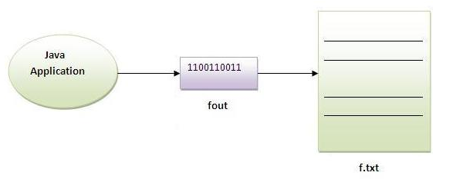

Slide 23
Example of FileOutputStream class
import java.io.*;
class Test{
public static void main(String args[]){
try{
FileOutputstream fout=new FileOutputStream("abc.txt");
String s=“Java is my favorite subject";
byte b[]=s.getBytes();//converting string into byte array
fout.write(b);
fout.close();
System.out.println("success...");
}catch(Exception e){
system.out.println(e);
}
}
}

Slide 24
output
Success…

Slide 25
Java FileInputStream class
Java FileInputStream class obtains input bytes from a file.It is used for reading streams of raw bytes such as image data. For reading streams of characters, consider using FileReader.
It should be used to read byte-oriented data for example to read image, audio, video etc.

Slide 26
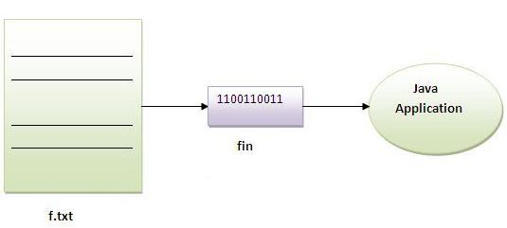

Slide 27
Example of FileInputStream class
import java.io.*;
class SimpleRead{
public static void main(String args[]){
try{
FileInputStream fin=new FileInputStream("abc.txt");
int i=0;
while((i=fin.read())!=-1){
System.out.println((char)i);
}
fin.close();
}catch(Exception e){system.out.println(e);}
}
}

Slide 28
Output
Java is my favorite Subject

Slide 29
Example of Reading the data of current file and writing it into another file
import java.io.*;
class ReadWrite{
public static void main(String args[])throws Exception{
FileInputStream fin=new FileInputStream(“javalogo.jpg");
FileOutputStream fout=new FileOutputStream(“javalogocopy.jpg");
int i=0;
while((i=fin.read())!=-1){
fout.write((byte)i);
}
fin.close();
}
}

Slide 30
Streams usage
Byte Streams
Character Streams
To perform file i/o operations on image, audio, video files.
To perform i/o operation on text files.

Slide 31
FileWriter and FileReader (File Handling in java)

Slide 32
FileWriter and FileReader (File Handling in java)
FileWriter and FileReader classes are used to write and read data from text files. These are character-oriented classes, used for file handling in java.
Java has suggested not to use the FileInputStream and FileOutputStream classes if you have to read and write the textual information.

Slide 33
FileWriter class
Java FileWriter class is used to write character-oriented data to the file.

Slide 34
Constructors of FileWriter class
Constructor | Description
FileWriter(String file) | creates a new file. It gets file name in string.
FileWriter(File file) | creates a new file. It gets file name in File object.

Slide 35
Methods of FileWriter class
Method | Description
1) public void write(String text) | writes the string into FileWriter.
2) public void write(char c) | writes the char into FileWriter.
3) public void write(char[] c) | writes char array into FileWriter.
4) public void flush() | flushes the data of FileWriter.
5) public void close() | closes FileWriter.

Slide 36
Java FileWriter Example
import java.io.*;
class Simple{
public static void main(String args[]){
try{
FileWriter fw=new FileWriter("abc.txt");
fw.write(“I am a java developer");
fw.close();
}catch(Exception e){System.out.println(e);}
System.out.println("success");
}
}

Slide 37
output
Success

Slide 38
FileReader class
FileReader class is used to read data from the file. It returns data in character format like FileInputStream class.

Slide 39
Constructors of FileReader class
Constructor | Description
FileReader(String file) | It gets filename in string. It opens the given file in read mode. If file doesn't exist, it throws FileNotFoundException.
FileReader(File file) | It gets filename in file instance. It opens the given file in read mode. If file doesn't exist, it throws FileNotFoundException.

Slide 40
Methods of FileReader class
Method | Description
1) public int read() | returns a character in ASCII form. It returns -1 at the end of file.
2) public void close() | closes FileReader.

Slide 41
FileReader Example
import java.io.*;
class Simple{
public static void main(String args[])throws Exception{
FileReader fr=new FileReader("abc.txt");
int i;
while((i=fr.read())!=-1)
System.out.println((char)i);
fr.close();
}
}

Slide 42
output
I am a Java developer ☺

Slide 43
Reading data from keyboard

Slide 44
Reading Data from Console
There are many ways to read data from the keyboard. For example:
InputStreamReader
Scanner
DataInputStream etc.

Slide 45
InputStreamReader class
InputStreamReader class can be used to read data from keyboard.It performs two tasks:
connects to input stream of keyboard
converts the byte-oriented stream into character-oriented stream

Slide 46
BufferedReader class
BufferedReader class can be used to read data line by line by readLine() method.

Slide 47
Example of reading data from keyboard by InputStreamReader and BufferdReader class
import java.io.*;
class Read{
public static void main(String args[])throws Exception{
InputStreamReader isr InputStreamReader(System.in);
BufferedReader br=new BufferedReader(isr);
System.out.println("Enter your name");
String name=br.readLine();
System.out.println("Welcome "+name);
}
}

Slide 48
Another Example of reading data from keyboard by InputStreamReader and BufferdReader class until the user writes stop
InputStreamReader r=new InputStreamReader(System.in);
BufferedReader br=new BufferedReader(r);
String name="";
while(!name.equals("stop")){
System.out.println("Enter data: ");
name=br.readLine();
System.out.println("data is: "+name);
}
br.close();
r.close();

Slide 49
Scanner class
There are various ways to read input from the keyboard, the java.util.Scanner class is one of them.
The Java Scanner class breaks the input into tokens using a delimiter that is whitespace bydefault. It provides many methods to read and parse various primitive values.
Java Scanner class is widely used to parse text for string and primitive types using regular expression.
Java Scanner class extends Object class and implements Iterator and Closeable interfaces.

Slide 50
Commonly used methods of Scanner class
Method | Description
public String next() | it returns the next token from the scanner.
public String nextLine() | it moves the scanner position to the next line and returns the value as a string.
public byte nextByte() | it scans the next token as a byte.
public short nextShort() | it scans the next token as a short value.
public int nextInt() | it scans the next token as an int value.
public long nextLong() | it scans the next token as a long value.
public float nextFloat() | it scans the next token as a float value.
public double nextDouble() | it scans the next token as a double value.

Slide 51
Scanner Example to get input from console
import java.util.Scanner;
class ScannerTest{
public static void main(String args[]){
Scanner sc=new Scanner(System.in);
System.out.println("Enter your rollno");
int rollno=sc.nextInt();
System.out.println("Enter your name");
String name=sc.next();
System.out.println("Enter your fee");
double fee=sc.nextDouble();
System.out.println("Rollno:"+rollno+" name:"+name+" fee:"+fee);
sc.close();
}
}

Slide 52
Scanner Example with delimiter
String input = "10 tea 20 coffee 30 tea buiscuits";
Scanner s = new Scanner(input).useDelimiter("\\s");
System.out.println(s.nextInt());
System.out.println(s.next());
System.out.println(s.nextInt());
System.out.println(s.next());
s.close();

Slide 53
Scanner Example to get input from console
import java.util.Scanner;
class ScannerTest{
public static void main(String args[]){
Scanner sc=new Scanner(System.in);
System.out.println("Enter your rollno");
int rollno=sc.nextInt();
System.out.println("Enter your name");
String name=sc.next();
System.out.println("Enter your fee");
double fee=sc.nextDouble();
System.out.println("Rollno:"+rollno+" name:"+name+" fee:"+fee);
sc.close();
}
}

Slide 54
Read file data using Scanner Note: Mention file path with file object
import java.io.File;
import java.io.FileNotFoundException;
import java.util.Scanner;
public class ScannerDemo {
public static void main(String[] args) throws FileNotFoundException {
File f = new File("abc.txt");
Scanner sc = new Scanner(f);
while (sc.hasNextLine()) {
System.out.print(sc.nextLine());
}
}
}

Slide 55
java.io.PrintStream class

Slide 56
java.io.PrintStream class
The PrintStream class provides methods to write data to another stream. The PrintStream class automatically flushes the data so there is no need to call flush() method. Moreover, its methods don't throw IOException.

Slide 57
Example of java.io.PrintStream class
import java.io.*;
class PrintStreamTest{
public static void main(String args[])throws Exception{
FileOutputStream fout=new FileOutputStream("mfile.txt");
PrintStream pout=new PrintStream(fout);
pout.println(1900);
pout.println("Hello Java");
pout.println("Welcome to Java");
pout.close();
fout.close();
}
}

Slide 58
Example of printf() method of java.io.PrintStream class:
class PrintStreamTest{
public static void main(String args[]){
int a = 10;
int b = 20;
int c = a+b;
System.out.printf("a=%d b=%d c=%d", a,b,c); //Note, out is the object of PrintStream class
}
}

Slide 59
java.io.PrintWriter class
The PrintWriter class provides methods to write data to another stream. The PrintWriter class automatically flushes the data so there is no need to call flush() method. Moreover, its methods don't throw IOException.

Slide 60
PrintWriter Example
import java.io.FileNotFoundException;
import java.io.PrintWriter;
public class PrintWriterDemo {
public static void main(String[] args) throws FileNotFoundException {
PrintWriter pw = new PrintWriter("amr.txt");
pw.println("hello");
pw.println("this");
pw.println("is");
pw.println("AMR");
pw.close();
} }

Slide 61
Serialization

Slide 62
Serialization in Java
Serialization in java is a mechanism of writing the state of an object into a byte stream.
It is mainly used in Hibernate, RMI, JPA, EJB, JMS technologies.
The reverse operation of serialization is called deserialization.
The String class by default implements java.io.Serializable interface by default.

Slide 63
Advantage of Java Serialization Or what-is-real-time-use-of-serialization
It's mainly use in networks where we want to travel an object over network.
It’s used in distributed applications

Slide 64
java.io.Serializable interface
Serializable is a marker interface (has no body). It is just used to "mark" java classes which support a certain capability.
It must be implemented by the class whose object you want to persist.
Let's see the example given below:

Slide 65
Student.java
import java.io.Serializable;
public class Student implements Serializable{
int id;
String name;
public Student(int id, String name) {
this.id = id;
this.name = name;
}
}

Slide 66
ObjectOutputStream class
The ObjectOutputStream class is used to write primitive data types and Java objects to an OutputStream.
Only objects that support the java.io.Serializable interface can be written to streams.

Slide 67
Important Methods
Method | Description
1) public final void writeObject(Object obj) throws IOException {} | writes the specified object to the ObjectOutputStream.
2) public void flush() throws IOException {} | flushes the current output stream.
3) public void close() throws IOException {} | closes the current output stream.

Slide 68
Example of Java Serialization
In this example, we are going to serialize the object of Student class. The writeObject() method of ObjectOutputStream class provides the functionality to serialize the object. We are saving the state of the object in the file named f.txt.

Slide 69
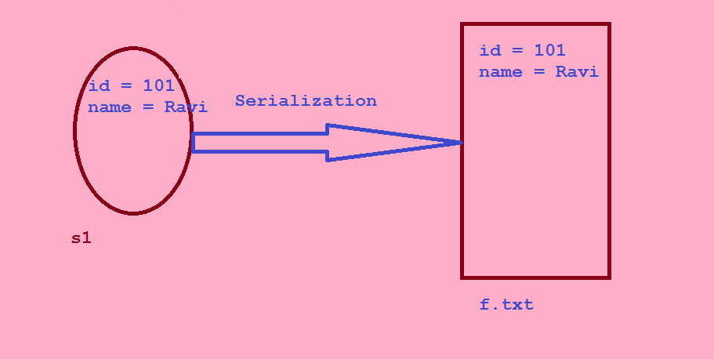
Serialization

Slide 70
Persist.java
import java.io.*;
class Persist{
public static void main(String args[])throws Exception{
Student s1 =new Student(211,"ravi");
FileOutputStream fout=new FileOutputStream("f.txt");
ObjectOutputStream out=new ObjectOutputStream(fout);
out.writeObject(s1);
out.flush();
System.out.println("success");
}
}

Slide 71
Deserialization in java
Deserialization is the process of reconstructing the object from the serialized state.It is the reverse operation of serialization.

Slide 72
ObjectInputStream class
An ObjectInputStream deserializes objects and primitive data written using an ObjectOutputStream.

Slide 73
Important Methods
Method | Description
1) public final Object readObject() throws IOException, ClassNotFoundException{} | reads an object from the input stream.
2) public void close() throws IOException {} | closes ObjectInputStream.

Slide 74
Example of Java Deserialization
import java.io.*;
class Depersist{
public static void main(String args[])throws Exception{
ObjectInputStream in=new ObjectInputStream(new FileInputStream("f.txt"));
Student s=(Student)in.readObject();
System.out.println(s.id+" "+s.name);
in.close();
}
}

Slide 75
If Serializable interface is not implemented to the class, what exception will come?
java.io.NotSerializableException

Slide 76
serialVersionUID:
It's the static final field used for
keep tracking serialization and deserialization process version vise.
public class Student implements Serializable{
private static final long serialVersionUID = 1L;
private int id;
private String name;
private transient int age;
…….
}

Slide 77
Java Serialization with static data member
If there is any static data member in a class, it will not be serialized because static is the part of class not object.

Slide 78
Employee.java
class Employee implements Serializable{
int id;
String name;
static String company=“MANGARAO IT PVT LTD";//it won't be serialized
public Student(int id, String name) {
this.id = id;
this.name = name;
}
}

Slide 79
Java Serialization with array or collection
Rule: In case of array or collection, all the objects of array or collection must be serializable. If any object is not serialiizable, serialization will be failed.

Slide 80
Externalizable in java
The Externalizable interface provides the facility of writing the state of an object into a byte stream in compress format. It is not a marker interface.
The Externalizable interface provides two methods:
public void writeExternal(ObjectOutput out) throws IOException
public void readExternal(ObjectInput in) throws IOException

Slide 81
Transient Keyword
If you don't want to serialize any data member of a class, you can mark it as transient.
Java transient keyword is used in serialization. If you define any data member as transient, it will not be serialized.
Let's take an example, I have declared a class as Student, it has three data members id, name and age. If you serialize the object, all the values will be serialized but I don't want to serialize one value, e.g. age then we can declare the age data member as transient.

Slide 82
Example of Transient Keyword

Slide 83
Student.java
import java.io.Serializable;
public class Student implements Serializable{
int id;
String name;
transient int age;//Now it will not be serialized
public Student(int id, String name,int age) {
this.id = id;
this.name = name;
this.age=age;
}
}

Slide 84
Code to serialize the object.
import java.io.*;
class PersistExample{
public static void main(String args[])throws Exception{
Student s1 =new Student(211,"ravi",22);//creating object
//writing object into file
FileOutputStream f=new FileOutputStream("f.txt");
ObjectOutputStream out=new ObjectOutputStream(f);
out.writeObject(s1);
out.flush();
out.close();
f.close();
System.out.println("success");
}
}

Slide 85
output
success

Slide 86
code for deserialization.
import java.io.*;
class DePersist{
public static void main(String args[])throws Exception{
ObjectInputStream in=new ObjectInputStream(new FileInputStream("f.txt"));
Student s=(Student)in.readObject();
System.out.println(s.id+" "+s.name+" "+s.age);
in.close();
}
}

Slide 87
output
211 ravi 0
As you can see, printing age of the student returns 0 because value of age was not serialized.

